Slide 1

Introduction to Operating Systems CS/COE 1550
Summer 2021
Sherif Khattab
ksm73@pitt.edu
(Some slides are from Silberschatz, Galvin and Gagne ©2013)

Slide 2
Course Goal and Objectives
Continue to demystify a good portion of the magic about how computers work so that you can write more efficient programs
The specific objectives are:
Modify and compile the Linux kernel to add system calls
Write multi-process/multi-thread programs free from race conditions and deadlocks
Simulate page-replacement algorithms for virtual memory management
Implement a user-land file system

Slide 3
Contact Info
Course website: http://www.cs.pitt.edu/~skhattab/cs1550/
Instructor: Sherif Khattab ksm73@pitt.edu
OH: https://khattab.youcanbook.me
MW: 13:00-15:00; F: by appointment
6307 Sennott Square, Virtual Office: https://pitt.zoom.us/my/khattab
Teaching Team:
Pratik Musale
Hanzhong Zheng
Recitations start this week!
Communication
End of week newsletter
Piazza, Canvas Messages, Email (Please expect a response within 72 hours)

Slide 4
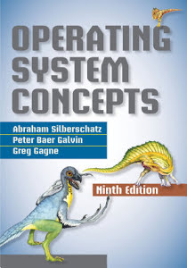
Textbook
Operating System Concepts (9th Edition)
Silberschatz, Galvin, and Gagne

Slide 5
Grading
40% on 4 projects
System programming using C
Posted on Canvas and submitted on Gradescope (auto-graded)
20% on two exams: 12% on higher and 8% on lower
18% on 12 weekly homework assignments
14% recitation: 5 labs using MIT’s Xv6 operating system and 4 quizzes on the projects
8% in-class Tophat questions (assigned as homework as well)

Slide 6
Canvas Walkthrough
Zoom links under Zoom (except office hours links under Syllabus)
Lectures posted on Tophat by end of each lecture day
Lecture and recitation recordings under Panopto Video
Pre- and Post-course test
Piazza for discussion
Gradescope and autograding policies
Homework attempts
GitHub Classroom
Academic Integrity
NameCoach

Slide 7
Expectations
Your continuous feedback is important!
Anonymous Qualtrics survey
Midterm and Final OMET
Your engagement is valued and encouraged
Attend the synchronous lectures
Watch the recordings day by day
Schedule office hours
Ask and answer questions on Piazza
…

Slide 8
Lecture structure (mostly)
Time | Description
~30-40 min | Announcements, QA on projects/labs/homework problems, muddiest points from previous lecture
~40-50 min | Lecturing
~10 min | Tophat questions
~10 min | Xv6 code
~5 min | QA and muddiest points

Slide 9
Why is this class (notoriously) hard?
Lots of concepts
Attend lectures and recitations (if you absolutely cannot attend live, watch the video recordings)
Study often!
Put effort into the weekly homework assignments
Projects are relatively hard
Refresh your C programming and GDB debugging skills (CS 0449!)
Start early and show up to office hours!

Slide 10
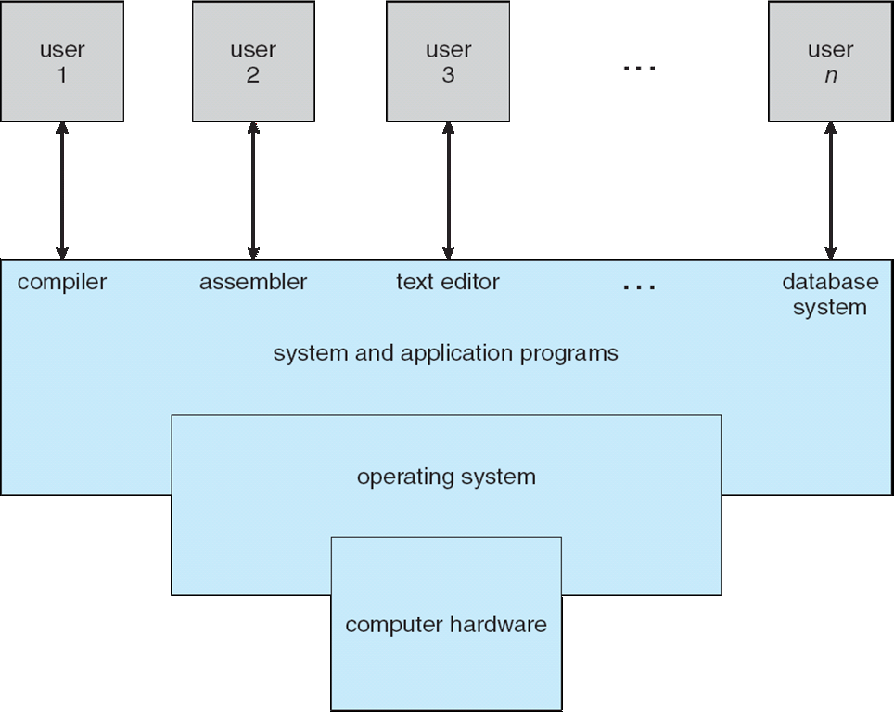
What is an Operating System?
A program that acts as an intermediary between a user of a computer and the computer hardware

Slide 11
What does an OS do?
Manages (controls and arbitrates) resources
Processors, Memory, Input/output devices, Communication devices, Storage, Software applications
Conflicting goals:
Performance vs. utilization
Provides abstractions to application programs
Ease of use
Virtualization
Protects resources

Slide 12
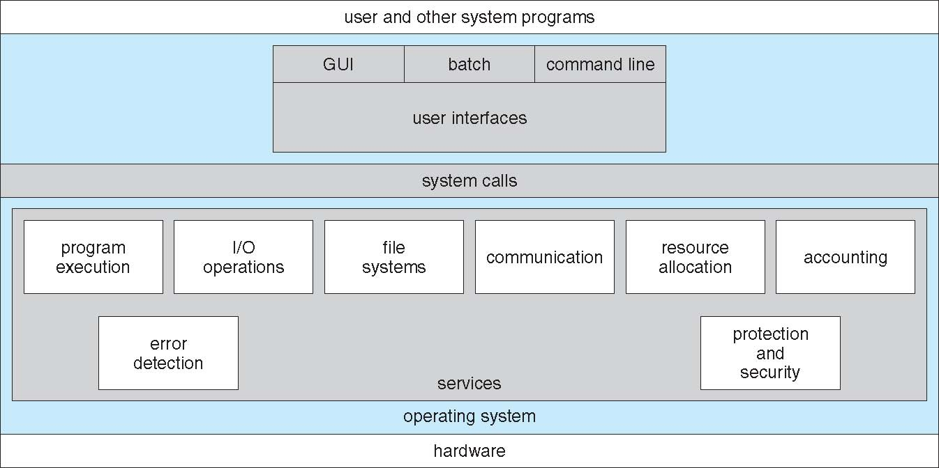
A View of Operating System Services

Slide 13
How does an OS work?
Two main enabling mechanisms:
Interrupts
Dual-mode operation of the CPU
Kernel mode and user mode

Slide 14
Interrupts
Interrupt transfers control to the interrupt service routine (ISR)
ISRs are segments of code that determine what action should be taken for each type of interrupt
The interrupt vector contains the addresses of all the service routines
Hardware or software:
Hardware interrupt by one of the devices
Software interrupt (exception or trap):
Request for operating system service
Software error (e.g., division by zero)
Other process problems include processes trying to modify each other’s or the operating system’s memory

Slide 15
Dual-mode Operation
Dual-mode operation allows OS to protect itself and other system components
User mode and kernel mode
Mode bit provided by hardware
Provides ability to distinguish when system is running user code or kernel code
Some instructions designated as privileged, only executable in kernel mode
System call changes mode to kernel, return from call resets it to user
Increasingly CPUs support multi-mode operations
virtual machine manager (VMM) mode for guest VMs

Slide 16
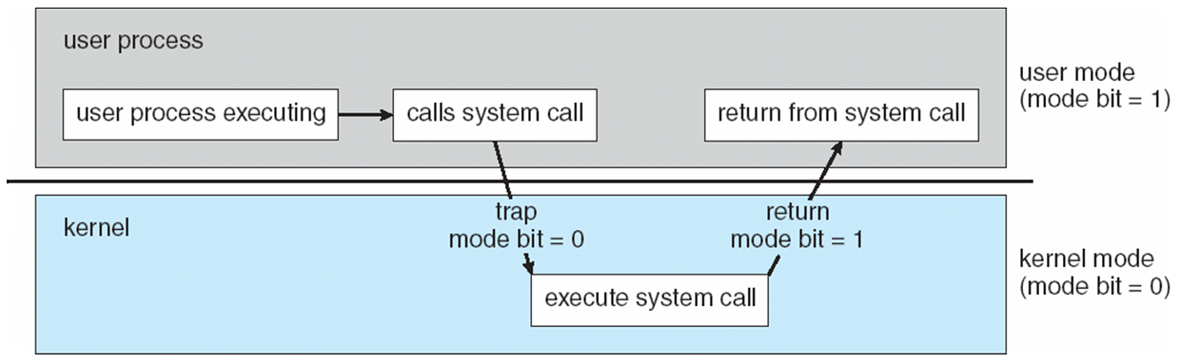
Transition from User to Kernel Mode

Slide 17
How does an OS (roughly) work?

Slide 18
What happens on a hardware interrupt?
6
1
4
7
5
9
2
3
8

Slide 19
System Calls
Programming interface to the services provided by the OS
Typically written in a high-level language (C or C++)
Mostly accessed by programs via a high-level Application Programming Interface (API) rather than direct system call use
Three most common APIs are Win32 API for Windows, POSIX API for POSIX-based systems (including virtually all versions of UNIX, Linux, and Mac OS X), and Java API for the Java virtual machine (JVM)

Slide 20
System Call Implementation
Typically, a number associated with each system call
System-call interface maintains a table indexed according to these numbers
The system call interface invokes the intended system call in OS kernel and returns status of the system call and any return values
The caller need know nothing about how the system call is implemented

Slide 21
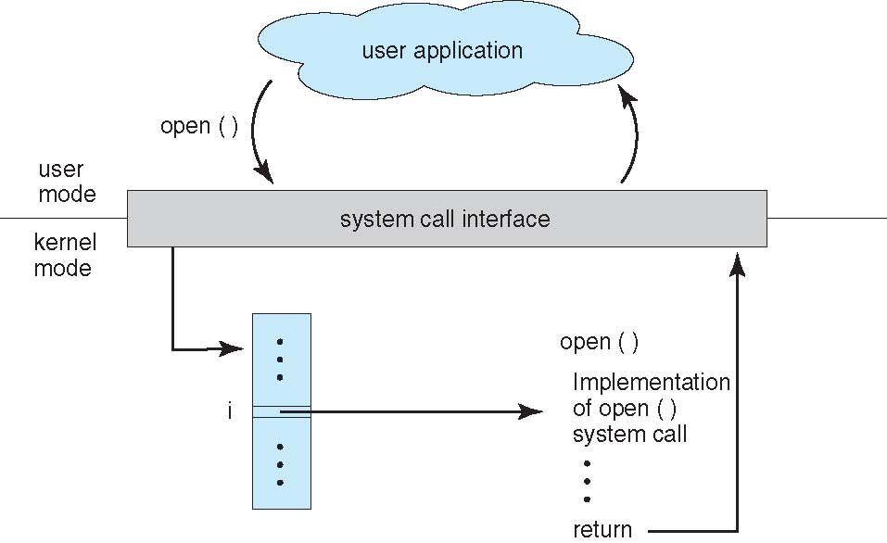
API – System Call – OS Relationship

Slide 22
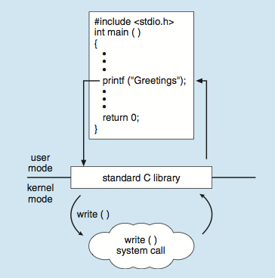
Standard C Library Example
C program invoking printf() library call, which calls write() system call

Slide 23
What happens on a syscall?
1
7
6
12
2
10
3
5
4
11
8
9

